Slide 1
UNIT-V
Instruction Level Parallelism
Notes:
<number>

Slide 2
Syllabus Contents
MIPS Implementation Overview, Digital Logic for MIPS Implementation, Single Data path for MIPS Architecture, Simple MIPS Implementation with Control Signals.
Overview of Instruction Pipelining, Performance Improvement, MIPS Instruction Set for Pipelining,
Pipeline Hazards: Structural, Data – Forwarding & Code Reordering, Control – Branch Prediction,
5 Stage Pipeline with Data path & Control for MIPS Architecture, Graphical Representation of Pipelines,
Data Hazards – Forwarding & Stalling for MIPS Pipeline, Control Hazards – Dynamic Branch Prediction & Delayed Branch for MIPS Pipeline. Superscalar Processors.

Slide 3
MIPS Implementation Overview
Notes:
<number>

Slide 4
MIPS Instruction Set Architecture
Inspired most architectures developed since the 80's
Used by NEC, Nintendo, Silicon Graphics, Sony
The name is not related to millions of instructions per second
MIPS stands for microcomputer without interlocked pipeline stages
Design goals: maximize performance and minimize cost and reduce design time
Designed for use with high-level programming languages
small set of instructions and addressing modes, easy for compilers

Slide 5
MIPS ISA(cont..)
Minimize/balance amount of work (computation and data flow) per instruction
allows for parallel execution
Load-store machine
large register set, minimize main memory access
Fixed instruction width (32-bits), small set of uniform instruction encodings
minimize control complexity, allow for more registers
All data operations are register to register;
the only memory references are pure load/store operations.

Slide 6
MIPS Implementation Overview
For every instruction, the first two steps are identical:
Send the program counter (PC) to the memory that contains the code and fetch the instruction from that memory.
Read one or two registers, using fields of the instruction to select the registers to read.
For the load word instruction, we need to read only one register, but most other instructions require that we read two registers.
After these two steps, the actions required to complete the instruction depend on the instruction class.
Fortunately, for each of the three instruction classes (memory-reference, arithmetic-logical, and branches), the actions are largely the same, independent of the exact instruction.
The simplicity and regularity of the MIPS instruction set simplifies the implementation by making the execution of many of the instruction classes similar.

Slide 7
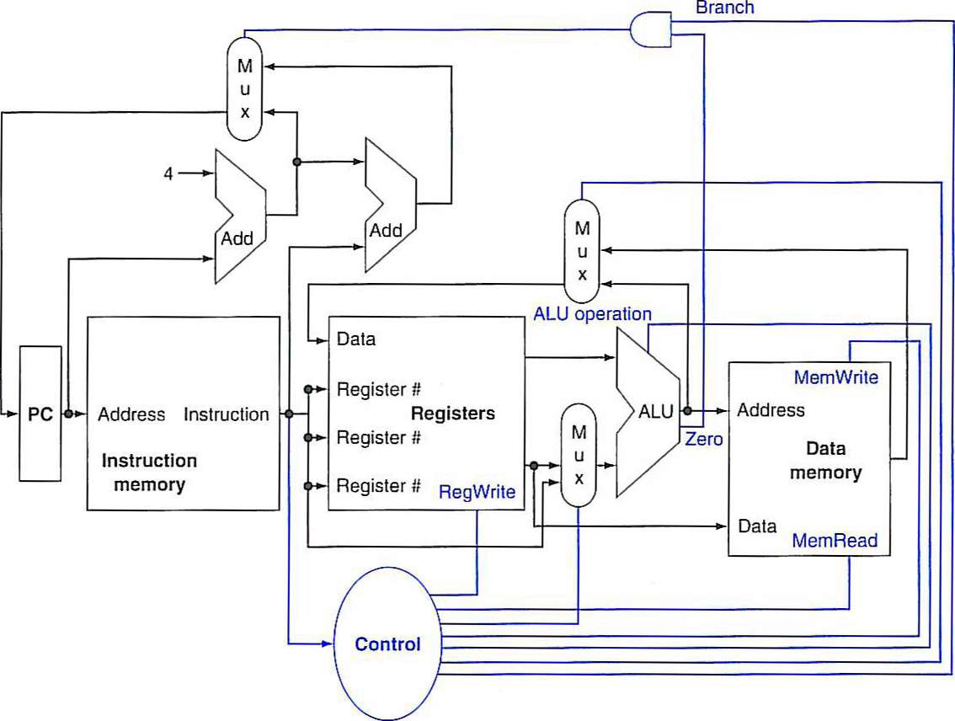
The basic implementation of the MIPS subset, including the necessary multiplexors and control lines

Slide 8
Digital Logic for MIPS Implementation
The top multiplexor ("Mux") controls what value replaces the PC (PC + 4 or the branch destination address); the multiplexor is controlled by the gate that "ANDs" together the Zero output of the ALU and a control signal that indicates that the instruction is a branch.
The middle multiplexor, whose output returns to the register file, is used to steer the output of the ALU (in the case of an arithmetic-logical instruction) or the output of the data memory (in the case of a load) for writing into the register file.

Slide 9
Digital Logic for MIPS Implementation (cont..)
Finally, the bottommost multiplexor is used to determine whether the second ALU input is from the registers (for an arithmetic-logical instruction OR a branch) or from the offset field of the instruction (for a load or store).
The added control lines are straightforward and determine the operation performed at the ALU, whether the data memory should read or write, and whether the registers should perform a write operation.

Slide 10
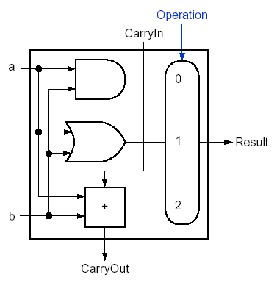
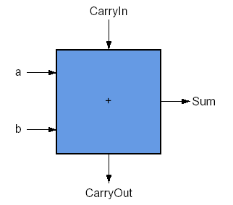
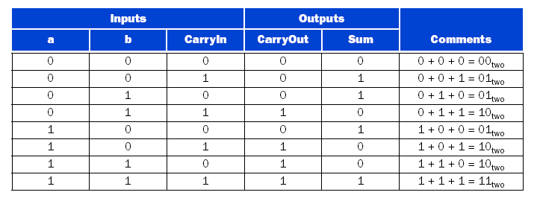
Example: Digital Logic for MIPS- ALU
Design a 1-bit ALU using AND gate, OR gate, a full adder, and a mux

Slide 11
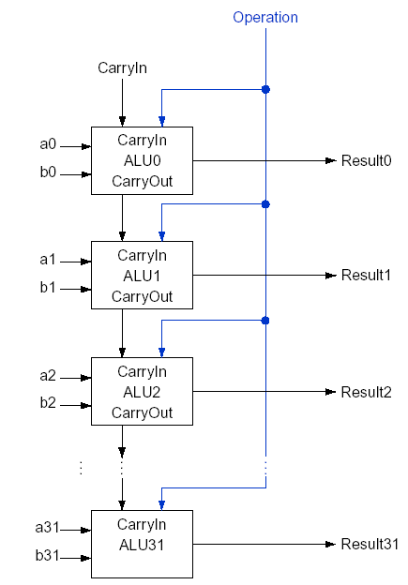
Digital Logic for MIPS- ALU (cont..)
Design a 32-bit ALU
by cascading 32 1-bit ALUs

Slide 12
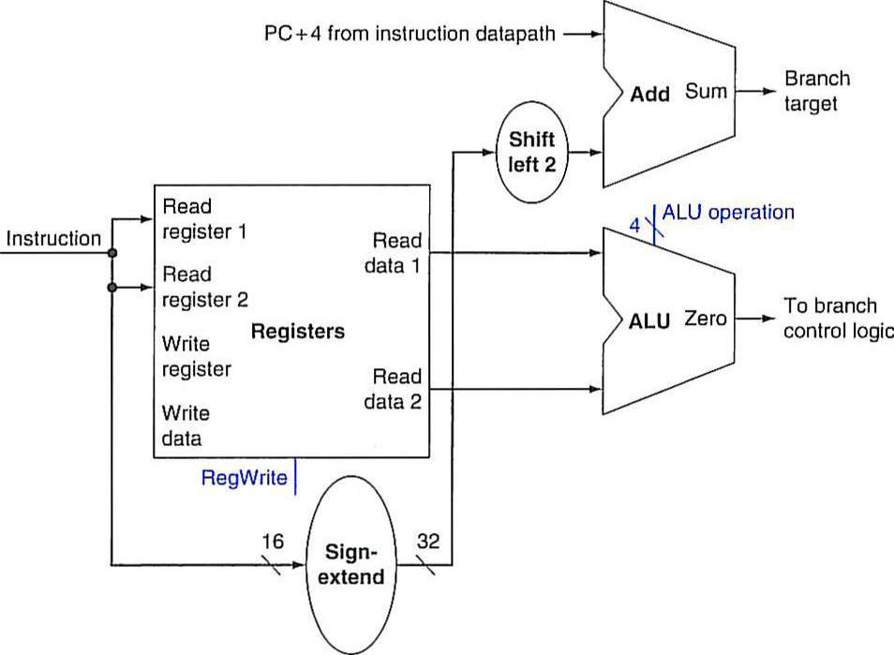
Example: The datapath for a branch
Uses the ALU to evaluate the branch condition and a separate adder to compute the branch target as the sum of the incremented PC and the sign-extended, lower 16 bits of the instruction (the branch displacement), shifted left 2 bits.

Slide 13
Single Data path for MIPS Architecture
Datapath Element :
A unit used to operate on or hold data within a processor.
In the MIPS implementation, the datapath elements include the instruction and data memories, the register file, the ALU, and adders.
Single Data path for MIPS Architecture:
The datapath components needed for the individual instruction classes can be combined into a single datapath and the control is added to complete the implementation.
This simplest datapath will attempt to execute all instructions in one clock cycle.
This means that no datapath resource can be used more than once per instruction, so any element needed more than once must be duplicated.

Slide 14
Single Data path for MIPS Architecture (cont..)

Slide 15
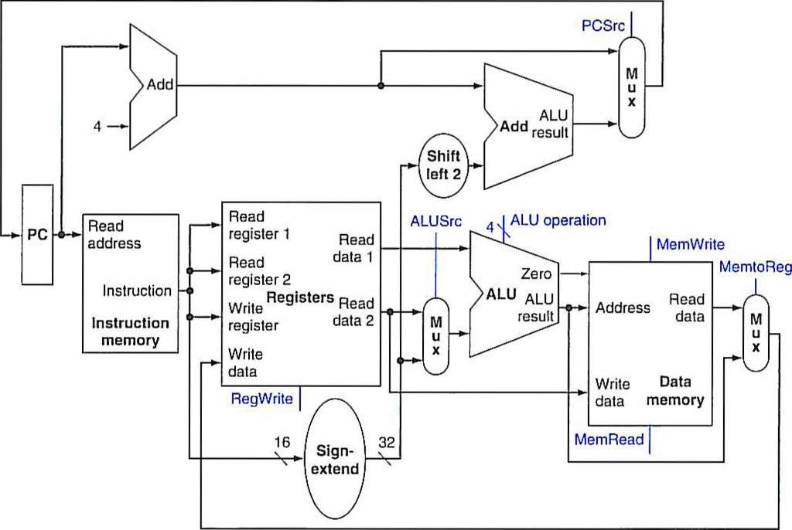
Simple datapath for MIPS architecture

Slide 16
Simple MIPS Implementation with Control Signals
The input to the control unit is the 6-bit opcode field from the instruction.
The outputs of the control unit consist of :
three 1-bit signals that are used to control multiplexors (RegDst, ALUSrc, and MemtoReg),
three signals for controlling reads and writes in the register file and data memory (RcgWrite, MemRead, and MemWrite),
a 1-bit signal used in determining whether to possibly branch (Branch)
a 2-bit control signal for the ALU (ALUOp).
An AND gate is used to combine the branch control signal and the Zero output from the ALU; the AND gate output controls the selection of the next PC.
Notice that PCSrc is now a derived signal, rather than one coming directly from the control unit.

Slide 17
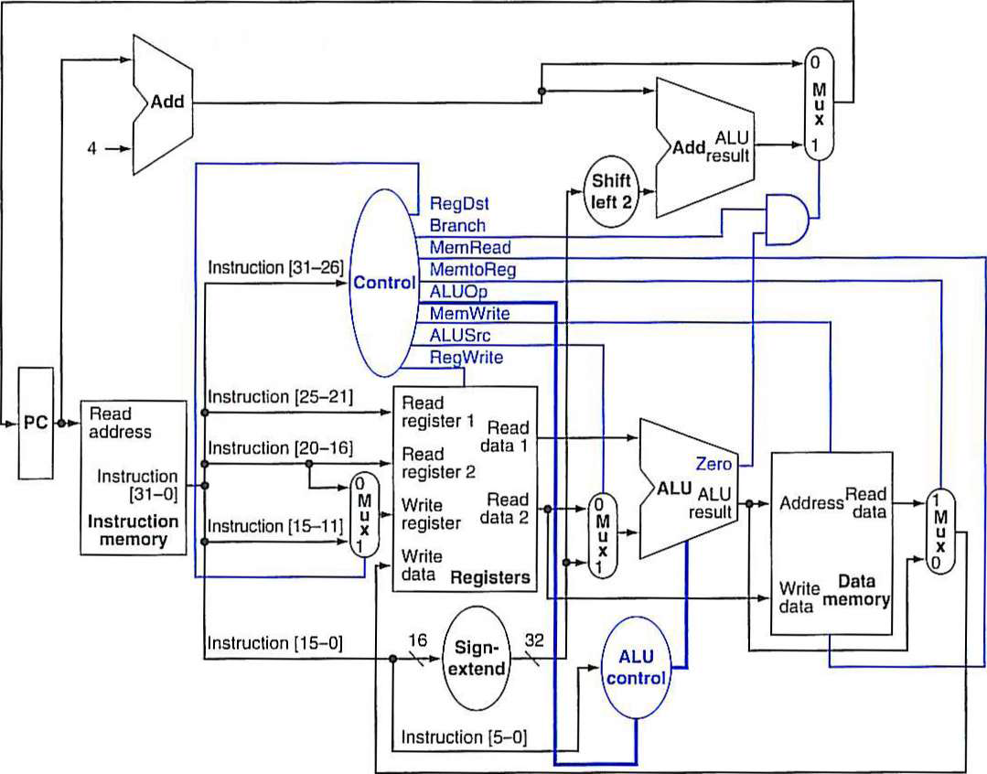
Simple Datapath with The Control Unit

Slide 18
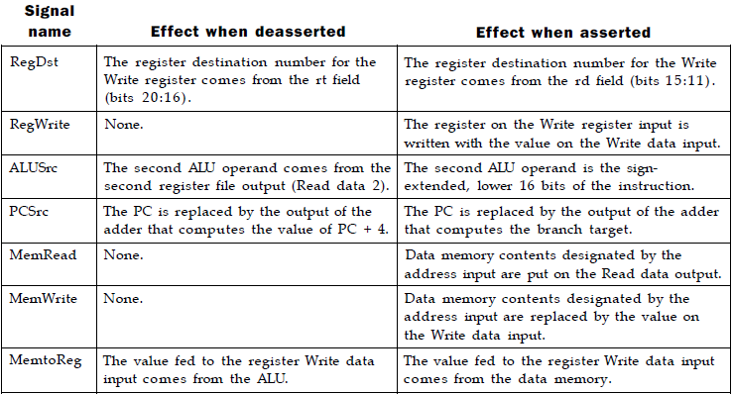
The Effect of Each of The Seven Control Signals

Slide 19
Overview of instruction pipelining & performance improvement
Notes:
<number>

Slide 20
Pipelining
Pipelining is an implementation technique in which multiple instructions are overlapped in execution.
It has the substantial advantage that, unlike programming a multiprocessor, it is fundamentally invisible to the programmer.
Pipelining only works is one does not attempt to execute at the same time two different operations that use the same datapath resource:
as an instance, if the datapath has a single ALU, this cannot compute concurrently the effective address of a load and the subtraction of the operands in another instruction
Using reduced (simple) instructions (namely RISC) makes it fairly easy to determine at each time which datapath resources are free and which are busy.

Slide 21
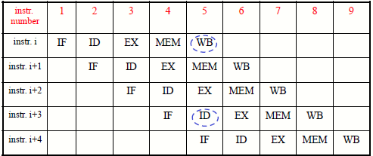
MIPS 5-Stage pipelining
MIPS instructions classically take five steps:
Fetch instruction from memory.
Read registers while decoding the instruction. The regular format of MIPS instructions allows reading and decoding to occur simultaneously.
Execute the operation or calculate an address.
Access an operand in data memory.
Write the result into a register.

Slide 22
MIPS 5-Stage pipelining (cont..)
Why are phases WB and ID highlighted in clock cycle 5?
What is peculiar with them?
Let instruction i be a load, and i+3 be an R-type: in cycle 5 the result from instruction i is being written in the register file and the operands for instruction i+3 are being read from the same file.
Well, it looks like we are trying to use the same resource in the same clock cycle for two different instructions …
Actually, this is allowed at those functional units that can be used twice during different phases of the same clock cycle.

Slide 23
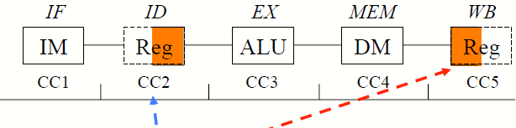
MIPS 5-Stage pipelining (cont..)
In the following figure depicting the execution pattern of a load instruction, each phase is associated to the unit is uses: the dotted part shows that the unit is not used in that portion of the clock cycle.
The register file is written in WB in the first half of the clock cycle, and it is read in ID in the second half of the clock cycle.

Slide 24
Pipeline Registers
The pipeline registers carry data and control from one stage to the next.
Values are copied along the registers until no longer needed
The temporary registers used in the unpipelined processor are unsuitable as the values they contain could be overwritten before being completely used
All registers needed to hold values temporarily between clock cycles within one instruction are contained in pipeline registers
A value needed in a later stage must be copied between pipeline registers until it is no longer needed

Slide 25
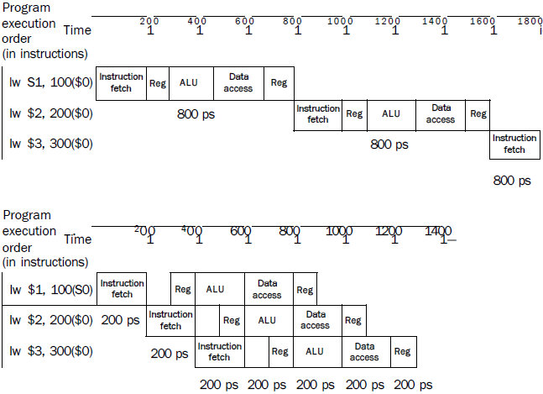
Single-cycle, nonpipelined execution(in top) Vs Pipelined Execution (in bottom)

Slide 26
Nonpipelined Vs Pipelined Execution Example (cont..)
In this example –
Both use the same hardware components.
There is a fourfold speed-up on average time between instructions, from 800 ps down to 200 ps.
It is assumed that the write to the register file occurs in the first half of the clock cycle and the read from the register file occurs in the second half.
The pipeline stage times of a computer are also limited by the slowest resource, either the ALU operation or the memory access.

Slide 27
Speed Up Equations for Pipelining
For simple RISC pipeline, CPI = 1:

Slide 28
Designing Instruction Sets for Pipelining
Notes:
<number>

Slide 29
Designing Instruction Sets for Pipelining
First, all MIPS instructions are having the same length.
This restriction makes it much easier to fetch instructions in the first pipeline stage and to decode them in the second stage.
Second, MIPS has only a few instruction formats, with the source register fields being located in the same place in each instruction.
This symmetry means that the second stage can begin reading the register file at the same time that the hardware is determining what type of instruction was fetched.
If MIPS instruction formats were not symmetric, we would need to split stage 2, resulting in six pipeline stages.

Slide 30
Designing Instruction Sets for Pipelining (cont..)
Third, memory operands only appear in loads or stores in MIPS.
This restriction means we can use the execute stage to calculate the memory address and then access memory in the following stage.
If we could operate on the operands in memory, as in the x86, stages 3 and 4 would expand to an address stage, memory stage, and then execute stage.
Fourth, operands must be aligned in memory.
Hence, there is no need to worry about a single data transfer instruction requiring two data memory accesses; the requested data can be transferred between processor and memory in a single pipeline stage.

Slide 31
pipeline Hazards
Notes:
<number>

Slide 32
Pipeline Hazards
There are situations in pipelining when the next instruction cannot execute in the following clock cycle. These events are called hazards.
Where one instruction cannot immediately follow another.
Types of hazards
Structural hazards - attempt to use the same resource by two or more instructions
Data hazards - attempt to use data before it is ready
Control hazards - attempt to make branching decisions before branch condition is evaluated
Pipeline stall: Also called bubble. A stall initiated in order to resolve a hazard.
Can always resolve hazards by waiting.

Slide 33
Structural Hazard
Structural hazard: When a planned instruction cannot execute in the proper clock cycle because the hardware does not support the combination of instructions that are set to execute.
The MIPS instruction set was designed to be pipelined, making it fairly easy for designers to avoid structural hazards when designing a pipeline.
Without two memories (data & instruction), MIPS pipeline could have a structural hazard.

Slide 34
Structural Hazard (cont..)
E.g.: Single Memory for instructions and data
Accessed by IF stage & Accessed at same time by MEM stage
Solutions:
Delay the second access by one clock cycle, OR
Provide separate memories for instructions & data
This is what the book does
This is called a “Harvard Architecture”
Real pipelined processors have separate caches
Some common Structural Hazards:
Memory: (already mentioned this)
Floating point:
Since many floating point instructions require many cycles, it’s easy for them to interfere with each other.
Starting up more of one type of instruction than there are resources.
For instance, the PA-8600 can support two ALU + two load/store instructions per cycle - that’s how much hardware it has available.

Slide 35
Graphical Representation- Multicycle Diagram

Slide 36
Multicycle Diagram (cont..)
Memory Conflict

Slide 37
One Memory Port Structural Hazards
Time (clock cycles)
Cycle 1
Cycle 2
Cycle 3
Cycle 4
Cycle 5
Cycle 6
Cycle 7
I
n
s
t
r.
O
r
d
e
r
Load
Ifetch
Reg
ALU
DMem
Reg
Instr 1
Ifetch
Reg
ALU
DMem
Reg
Instr 2
Ifetch
Reg
ALU
DMem
Reg
Stall
Bubble
Bubble
Bubble
Bubble
Bubble
Instr 3
Ifetch
Reg
ALU
DMem
Reg

Slide 38
Dealing with Structural Hazards
Stall
low cost, simple
Increases CPI
use for rare case since stalling has performance effect
Pipeline hardware resource
useful for multi-cycle resources
good performance
sometimes complex e.g., RAM
Replicate resource
good performance
increases cost (+ maybe interconnect delay)
useful for cheap or divisible resources

Slide 39
Dealing with Structural Hazards (cont..)
Structural hazards are reduced with these rules:
Each instruction uses a resource at most once
Always use the resource in the same pipeline stage
Use the resource for one cycle only
Many RISC ISAs are designed with this in mind .
Sometimes very difficult to do this.
E.g. memory of necessity is used in the IF and MEM stages.

Slide 40
Data Hazard
Data hazard: Also called a pipeline data hazard. When a planned instruction cannot execute in the proper clock cycle because data that is needed to execute the instruction is not yet available.
In a computer pipeline, data hazards arise from the dependence of one instruction on an earlier one that is still in the pipeline
E.g. suppose we have an add instruction followed immediately by a subtract instruction that uses the sum ($s0):
add $s0, $t0, $t1
sub $t2 , $s0 , St3
Without intervention, a data hazard could severely stall the pipeline. The
add instruction doesn't write its result until the fifth stage, meaning that
we would have to waste three clock cycles in the pipeline.

Slide 41
Data Hazards: Graphical Representation
Data hazards occur when data is used before it is ready
The use of the result of the SUB instruction in the next two instructions causes a data hazard, since the register $2 is not written until after those instructions read it.

Slide 42
Data Hazards (cont..)
Execution Order is:
Instr_{I}
_{InstrJ}
Read After Write (RAW)
InstrJ tries to read operand before InstrI writes it
Caused by a “Dependence” (in compiler nomenclature). This hazard results from an actual need for communication.
I: add r1,r2,r3
J: sub r4,r1,r3

Slide 43
Data Hazards (cont..)
Execution Order is:
Instr_{I}
_{InstrJ}
Write After Read (WAR)
InstrJ tries to write operand before InstrI reads i
_{Gets wrong operand}
Called an “anti-dependence” by compiler writers.
This results from reuse of the name “r1”.
Can’t happen in MIPS 5 stage pipeline because:
All instructions take 5 stages, and
Reads are always in stage 2, and
_{Writes are always in stage 5}
I: sub r4,r1,r3
J: add r1,r2,r3
K: mul r6,r1,r7

Slide 44
Data Hazards (cont..)
Execution Order is:
Instr_{I}
_{InstrJ}
Write After Write (WAW):
InstrJ tries to write operand before InstrI writes it
Leaves wrong result ( InstrI not InstrJ )
Called an “output dependence” by compiler writers
This also results from the reuse of name “r1”.
Can’t happen in MIPS 5 stage pipeline because:
All instructions take 5 stages, and
_{Writes are always in stage 5}
I: sub r1,r4,r3
J: add r1,r2,r3
K: mul r6,r1,r7

Slide 45
Data Hazard Detection in MIPS (1)
Read after Write
IF/ID
ID/EX
EX/MEM
MEM/WB
1a: EX/MEM.RegisterRd = ID/EX.RegisterRs
1b: EX/MEM.RegisterRd = ID/EX.RegisterRt
2a: MEM/WB.RegisterRd = ID/EX.RegisterRs
2b: MEM/WB.RegisterRd = ID/EX.RegisterRt
EX hazard
MEM hazard

Slide 46
Data Hazards (cont..)
There are three types of data hazards:
Read after write (RAW), or true dependency:
An instruction modifies a register or memory location and a succeeding instruction reads the data in that memory or register location.
A hazard occurs if the read takes place before the write operation is complete.
Write after read (WAR), or antidependency:
An instruction reads a register or memory location and a succeeding instruction writes to the location.
A hazard occurs if the write operation completes before the read operation takes place.
Write after write (WAW), or output dependency:
Two instructions both write to the same location.
A hazard occurs if the write operations take place in the reverse order of the intended sequence.

Slide 47
Data Hazards (cont..)
Three types of data hazards
RAW (MIPS)
WAW (not in MIPS)
WAR (not in MIPS)
Solutions for Data Hazards
Stalling
Forwarding:
Also called bypassing.
A method of resolving a data hazard by retrieving the missing data element from internal buffers rather than waiting for it to arrive from programmer visible registers or memory.
connect new value directly to next stage
Reordering

Slide 48
Data Hazard - Stalling

Slide 49
Data Hazards – Stalling (cont..)
Simple Solution to RAW
Hardware detects RAW and stalls
Assumes register written then read each cycle
low cost to implement, simple
Try to minimize stalls
Minimizing RAW stalls
Bypass/forward/short­circuit
Use data before it is in the register
reduces/avoids stalls
complex
Crucial for common RAW hazards

Slide 50
Data Hazards - Forwarding
Key idea: connect new value directly to next stage
Still read s0, but ignore in favor of new result

Slide 51
Data Hazards - Forwarding
STALL still required for load - data avail. after MEM
MIPS architecture calls this delayed load, initial implementations required compiler to deal with this

Slide 52
Data Hazards
This is another representation of the stall.
LW R1, 0(R2) | IF | ID | EX | MEM | WB
SUB R4, R1, R5 |  | IF | ID | EX | MEM | WB
AND R6, R1, R7 |  |  | IF | ID | EX | MEM | WB
OR R8, R1, R9 |  |  |  | IF | ID | EX | MEM | WB
LW R1, 0(R2) | IF | ID | EX | MEM | WB
SUB R4, R1, R5 |  | IF | ID | stall | EX | MEM | WB
AND R6, R1, R7 |  |  | IF | stall | ID | EX | MEM | WB
OR R8, R1, R9 |  |  |  | stall | IF | ID | EX | MEM | WB

Slide 53
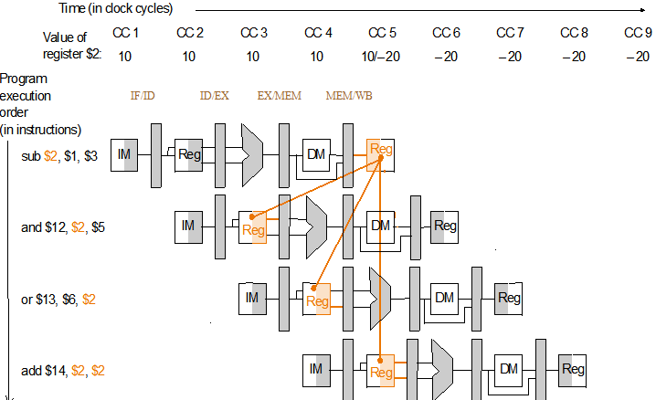
Data Hazards: Forwarding
Key idea: connect data internally before it's stored

Slide 54
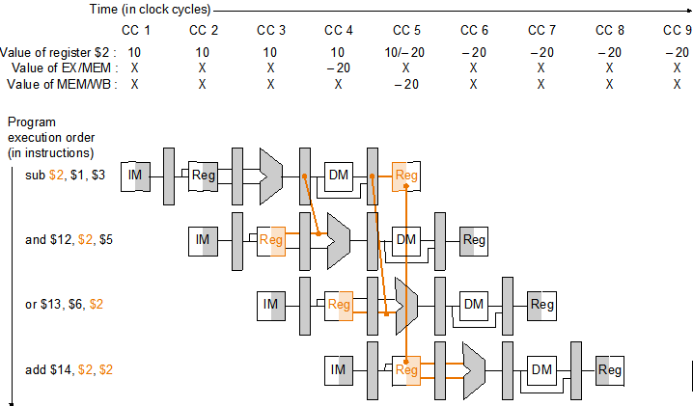
Data Hazard Solution: Forwarding
Key idea: connect data internally before it's stored
Assumption: The register file forwards values that are read and written during the same cycle.

Slide 55
Data Hazards - Reordering Instructions
Assuming we have data forwarding, what are the hazards in this code?
lw $t0, 0($t1)
lw $t2, 4($t1)
sw $t2, 0($t1)
sw $t0, 4($t1)
Reorder instructions to remove hazard:
lw $t0, 0($t1)
lw $t2, 4($t1)
sw $t0, 4($t1)
sw $t2, 0($t1)

Slide 56
Control Hazards
Control hazard: Also called branch hazard. When the proper instruction cannot execute in the proper pipeline clock cycle because the instruction that was fetched is not the one that is needed; that is, the flow of instruction addresses is not what the pipeline expected.
A control hazard is when we need to find the destination of a branch, and can’t fetch any new instructions until we know that destination.
A branch is either
Taken: PC <= PC + 4 + Immediate
Not Taken: PC <= PC + 4

Slide 57
Control Hazards
Control Hazard on Branches : Three Stage Stall
10: beq r1,r3,36
Ifetch
Reg
ALU
DMem
Reg
14: and r2,r3,r5
Ifetch
Reg
ALU
DMem
Reg
18: or r6,r1,r7
Ifetch
Reg
ALU
DMem
Reg
22: add r8,r1,r9
Ifetch
Reg
ALU
DMem
Reg
36: xor r10,r1,r11
Ifetch
Reg
ALU
DMem
Reg
The penalty when branch take is 3 cycles!

Slide 58
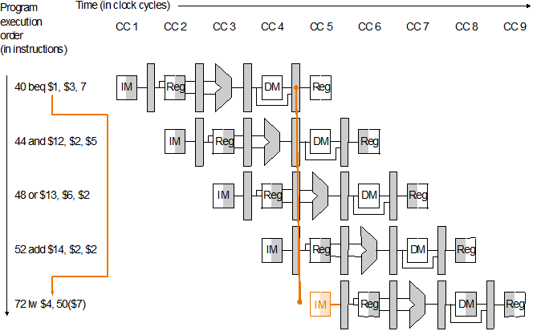
Branch Hazards
Just stalling for each branch is not practical
Common assumption: branch not taken
When assumption fails: flush three instructions

Slide 59
Control Hazard Solutions
Stall
stop loading instructions until result is available
Predict
assume an outcome and continue fetching (undo if prediction is wrong)
lose cycles only on mis-prediction
Delayed branch
specify in architecture that the instruction immediately following branch is always executed

Slide 60
superscalar processors
Notes:
<number>

Slide 61
Superscalar Processor
A superscalar processor is one in which multiple independent instruction pipelines are used.
Each pipeline consists of multiple stages, so that each pipeline can handle multiple instructions at a time.
Multiple pipelines introduce a new level of parallelism, enabling multiple streams of instructions to be processed at a time.
Common instructions (arithmetic, load/store, conditional branch) can be initiated and executed independently
A superscalar processor exploits what is known as instruction-level parallelism, which refers to the degree to which the instructions of a program can be executed in parallel.
Equally applicable to RISC & CISC.
In practice usually RISC

Slide 62
Superscalar Processor (cont..)
A superscalar processor typically fetches multiple instructions at a time and then attempts to find nearby instructions that are independent of one another and can therefore be executed in parallel.
If the input to one instruction depends on the output of a preceding instruction, then the latter instruction cannot complete execution at the same time or before the former instruction.
Once such dependencies have been identified, the processor may issue and complete instructions in an order that differs from that of the original machine code.

Slide 63
Superscalar Processor (cont..)
The processor may eliminate some unnecessary dependencies by the use of additional registers and the renaming of register references in the original code.
Whereas pure RISC processors often employ delayed branches to maximize the utilization of the instruction pipeline, this method is less appropriate to a superscalar machine.
Instead, most superscalar machines use traditional branch prediction methods to improve efficiency.

Slide 64
Why Superscalar?
It refers to a machine that is designed to improve the performance of the execution of scalar instructions
Most operations are on scalar quantities
The superscalar approach represents the next step in the evolution of high-performance general-purpose processors.
The essence of the superscalar approach is the ability to execute instructions independently and concurrently in different pipelines.
The concept can be further exploited by allowing instructions to be executed in an order different from the program order.
Notes:
<number>

Slide 65
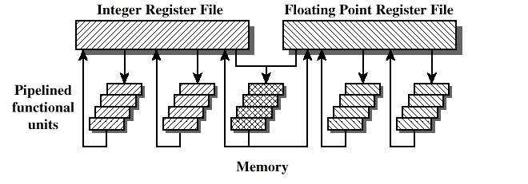
General Superscalar Organization
There are multiple functional units, each of which is implemented as a pipeline, which support parallel execution of several instructions.
In this example, two integer, two floating-point, and one memory (either load or store) operations can be executing at the same time.

Slide 66
Superpipelined
Many pipeline stages need less than half a clock cycle
Double internal clock speed gets two tasks per external clock cycle
Superscalar allows parallel fetch execute
Notes:
<number>

Slide 67
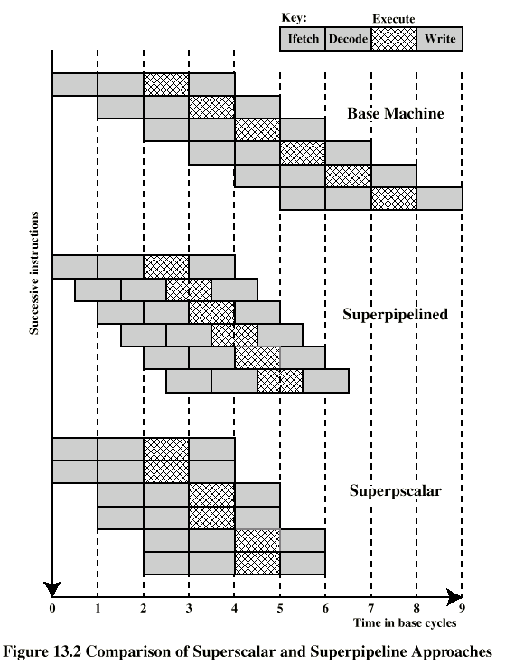
Superscalar Vs Superpipeline
Notes:
<number>

Slide 68
Limitations of Superscalar Organization
Instruction level parallelism
It refers to the degree to which, on average, the instructions of a program can be executed in parallel.
Compiler based optimisation
Hardware techniques
Limited by 5 factors:
True data dependency
Procedural dependency
Resource conflicts
Output dependency
Antidependency (also called write after read (WAR) dependency)
Notes:
<number>

Slide 69
True Data Dependency
ADD r1, r2 (r1 := r1+r2;)
MOVE r3,r1 (r3 := r1;)
Can fetch and decode second instruction in parallel with first
Can NOT execute second instruction until first is finished
Notes:
<number>

Slide 70
Procedural Dependency
Can not execute instructions after a branch in parallel with instructions before a branch
Also, if instruction length is not fixed, instructions have to be decoded to find out how many fetches are needed
This prevents simultaneous fetches
Notes:
<number>

Slide 71
Resource Conflict
Two or more instructions requiring access to the same resource at the same time
e.g. two arithmetic instructions
Can duplicate resources
e.g. have two arithmetic units
Notes:
<number>

Slide 72
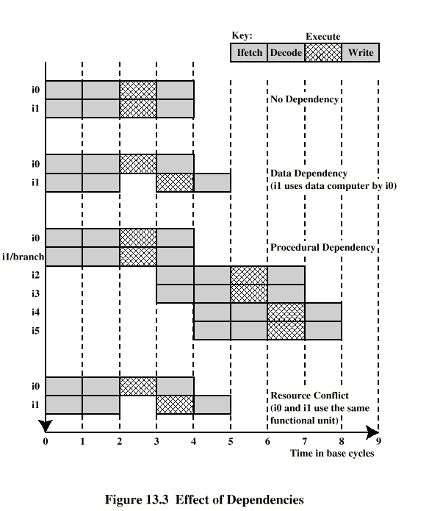
Effect of
Dependencies
Notes:
<number>

Slide 73
Design Issues
Instruction level parallelism
Instructions in a sequence are independent
Execution can be overlapped
Governed by data and procedural dependency
Machine Parallelism
Ability to take advantage of instruction level parallelism
Governed by number of parallel pipelines
Notes:
<number>

Slide 74
Instruction Issue Policy
Three types of important orderings:
Order in which instructions are fetched
Order in which instructions are executed
Order in which instructions change registers and memory
To optimize utilization of the various pipeline elements, the processor will need to alter one or more of these orderings with respect to the ordering to be found in a strict sequential execution.
The one constraint on the processor is that the result must be correct.
Notes:
<number>

Slide 75
Instruction Issue Policy (cont..)
General categories of superscalar instruction issue policies :
In-order issue with in-order completion
In-order issue with out-of-order completion
Out-of-order issue with out-of-order completion

Slide 76
In-Order Issue In-Order Completion (1)
Issue instructions in the order they occur
Not very efficient
May fetch >1 instruction
Instructions must stall if necessary
Example: The example assumes the following contraints on a six-instruction code fragment:
I1 requires two cycles to execute.
I3 and I4 conflict for the same functional unit.
I5 depends on the value produced by I4.
I5 and I6 conflict for a functional unit.
Notes:
<number>

Slide 77
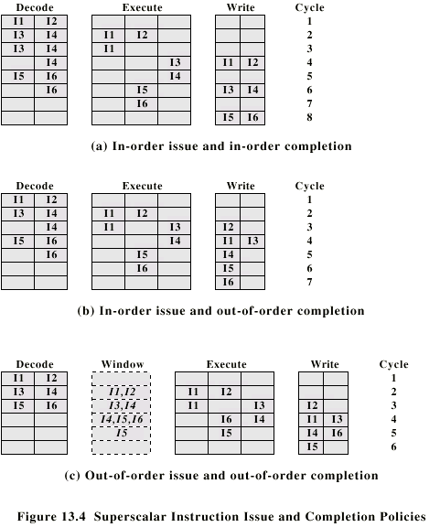
In-Order Issue In-Order Completion (Diagram) (2)
Notes:
<number>

Slide 78
In-Order Issue
Out-of-Order Completion (1)
Out-of-order completion is used in scalar RISC processors to improve the performance of instructions that require multiple cycles.
Example illustrates its use on a superscalar processor.
Instruction I2 is allowed to run to completion prior to I1.
This allows I3 to be completed earlier, with the net result of a savings of one cycle.
Notes:
<number>

Slide 79
In-Order Issue Out-of-Order Completion (Diagram) (2)
Notes:
<number>

Slide 80
In-Order Issue
Out-of-Order Completion (3)
With out-of-order completion, any number of instructions may be in the execution stage at any one time, up to the maximum degree of machine parallelism across all functional units.
Instruction issuing is stalled by a resource conflict, a data dependency, or a procedural dependency.
Output dependency (Write After Write -WAW)
R3:= R3 + R5; (I1)
R4:= R3 + 1; (I2)
R3:= R5 + 1; (I3)
I2 depends on result of I1 - data dependency
If I3 completes before I1, the result from I1 will be wrong - output (read-write) dependency

Slide 81
In-Order Issue
Out-of-Order Completion (4)
Out-of-order completion requires more complex instruction issue logic than in-order completion.
In addition, it is more difficult to deal with instruction interrupts and exceptions.
When an interrupt occurs, instruction execution at the current point is suspended, to be resumed later.
The processor must assure that the resumption takes into account that, at the time of interruption, instructions ahead of the instruction that caused the interrupt may already have completed.

Slide 82
Out-of-Order Issue
Out-of-Order Completion (1)
With in-order issue:
the processor will only decode instructions up to the point of a dependency or conflict.
No additional instructions are decoded until the conflict is resolved.
As a result, the processor cannot look ahead of the point of conflict to subsequent instructions that may be independent of those already in the pipeline and that may be usefully introduced into the pipeline.
To allow out-of-order issue, it is necessary to decouple the decode and execute stages of the pipeline.

Slide 83
Out-of-Order Issue
Out-of-Order Completion (2)
Decoupling of decode from execution stage is done with a buffer referred to as an instruction window.
With this organization, after a processor has finished decoding an instruction, it is placed in the instruction window.
As long as this buffer is not full, the processor can continue to fetch and decode new instructions.
When a functional unit becomes available,
an instruction from the instruction window may be issued to the execute stage.
Any instruction may be issued, provided that (1) it needs the particular functional unit that is available, and (2) no conflicts or dependencies block this instruction.
Notes:
<number>

Slide 84
Out-of-Order Issue
Out-of-Order Completion (3)
Since instructions have been decoded, processor can look ahead.
It allows the processor to identify independent instructions that can be brought into the execute stage.
Instructions are issued from the instruction window with little regard for their original program order.
The only constraint is that the program execution behaves correctly.

Slide 85
Out-of-Order Issue
Out-of-Order Completion (4)
Example:
During each of the first three cycles, two instructions are fetched into the decode stage.
During each cycle, subject to the constraint of the buffer size, two instructions move from the decode stage to the instruction window.
In this example, it is possible to issue instruction I6 ahead of I5 (as I5 depends on I4, but I6 does not).
Thus, one cycle is saved in both the execute and write-back stages, and the end-to-end savings, compared with diagram of In-Order Issue Out-of-Order Completion ,is one cycle.

Slide 86
Out-of-Order Issue Out-of-Order Completion (Diagram) (5)
Notes:
<number>

Slide 87
Out-of-Order Issue
Out-of-Order Completion (6)
An instruction cannot be issued if it violates a dependency or conflict.(same as prior categories)
The difference is that more instructions are available for issuing, reducing the probability that a pipeline stage will have to stall.
Antidependency (Write after read-WAR)
R3:=R3 + R5; (I1)
R4:=R3 + 1; (I2)
R3:=R5 + 1; (I3)
R7:=R3 + R4; (I4)
I3 can not complete before I2 starts as I2 needs a value in R3 and I3 changes R3
Notes:
<number>

Slide 88
Out-of-Order Completion
One common technique that is used to support out-of-order completion is the reorder buffer.
The reorder buffer is temporary storage for results completed out of order that are then committed to the register file in program order.

Slide 89
Register Renaming
Output and anti-dependencies occur because register contents may not reflect the correct ordering from the program
May result in a pipeline stall
Registers allocated dynamically
i.e. registers are not specifically named
Notes:
<number>

Slide 90
Register Renaming example
R3b:=R3a + R5a (I1)
R4b:=R3b + 1 (I2)
R3c:=R5a + 1 (I3)
R7b:=R3c + R4b (I4)
Without subscript refers to logical register in instruction
With subscript is hardware register allocated
Note R3a R3b R3c
Notes:
<number>

Slide 91
Machine Parallelism
Notes:
<number>

Slide 92
Branch Prediction
80486 fetches both next sequential instruction after branch and branch target instruction
Gives two cycle delay if branch taken
Notes:
<number>

Slide 93
Branch Prediction
RISC- Delayed Branch:
Calculate result of branch before unusable instructions pre-fetched
Always execute single instruction immediately following branch
It keeps pipeline full while fetching new instruction stream
Superscalar processors:
Delayed branch is not as good for superscalar processors
Multiple instructions need to execute in delay slot
Instruction dependence problems
So, superscalar processors revert to pre-RISC techniques of branch prediction
Notes:
<number>

Slide 94
Superscalar Execution (1)
Static Program to be executed:
consists of a linear sequence of instructions.
written by the programmer or generated by the compiler.
Instruction fetch process:
used to form a dynamic stream of instructions by handling branch prediction
This stream is examined for dependencies, and by removing artificial dependencies, the processor then dispatches the instructions into a window of execution.

Slide 95
Superscalar Execution (2)
Execution window:
instructions no longer form a sequential stream but are structured according to their true data dependencies.
Instruction execution :
The processor performs the execution stage of each instruction in an order determined by the true data dependencies and hardware resource availability.
Instruction reorder and commit:
Finally, instructions are conceptually put back into sequential order and their results are recorded.

Slide 96
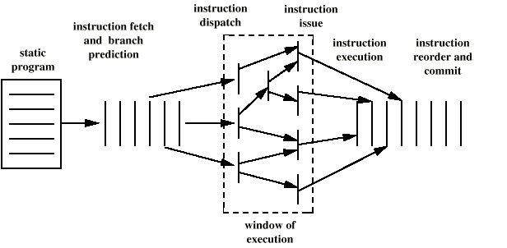
Superscalar Execution(2)
Notes:
<number>

Slide 97
Superscalar Implementation
Simultaneously fetch multiple instructions
Logic to determine true dependencies involving register values
Mechanisms to communicate these values
Mechanisms to initiate multiple instructions in parallel
Resources for parallel execution of multiple instructions
Mechanisms for committing process state in correct order
Notes:
<number>

